Slide 1

Green Pace
Security Policy Presentation
Developer: Hatcher Blair

Slide 2

OVERVIEW: DEFENSE IN DEPTH
This policy aims to ensure that all potential data breaches will be prevented in the future. To accomplish this, we have outlined ways to prevent vulnerabilities and best practices when moving the code base into deployment.

Slide 3
THREATS MATRIX
Impact
 | Negligible | Minor | Medium | High
Very Likely
Likely |  |  | STR51-CPP IDS00-J
Probable |  |  | STR32-C EXP33-C MSC03-J ERR50-CPP | INT31-C
Unlikely |  |  | FIO51-CPP
Very Unlikely
Likelihood

Slide 4
10 PRINCIPLES
Validate Input Data
Heed Compiler Warnings
Architect and Design for Security Policies
Keep it Simple
Default Deny
Adhere to the Principle of Least Privilege
Sanitize Data Sent to Other Systems
Practice Defense in Depth
Use Effective Quality Assurance Techniques
Adopt a Secure Coding Standard

Slide 5
CODING STANDARDS
INT31-C – Ensure that integer conversions do not result in lost or misinterpreted data
STR51-CPP – Do not attempt to create a std::string from a null pointer
STR32-C – Do not pass a non null-terminated character sequence to a library function that expects a string
IDS00-J – Prevent SQL Injection (We are going to talk about this a lot today)
EXP33-C – Do not read uninitialized memory
MSC03-J – Never hard code sensitive information
FIO51-CPP – Close files when they are no longer needed
ERR50-CPP – Do not abruptly terminate the program
MSC60-J – Do not use assertions to verify the absence of runtime errors
ERR51-J – Prefer user-defined exceptions over more general exception types

Slide 6
ENCRYPTION POLICIES
Encryption (Data) in Flight: Protecting Data While it is Being Transferred
Encryption (Data) at Rest: Protecting Data in Long Term Storage
Encryption (Data) in Use: Protecting Data During Computations

Slide 7
TRIPLE-A POLICIES
Authentication: Ensure User is Who They Say They are
Authorization: Ensure User is Allowed to Access Data
Accounting: Keep Records of Reads, Writes, and Logins

Slide 8
Unit Testing
IDS00-J:
Verify Regular Functionality
Verify Front End Check
Verify Back End Check
Front End Injection Prevented
Back End Injection Prevented

Slide 9
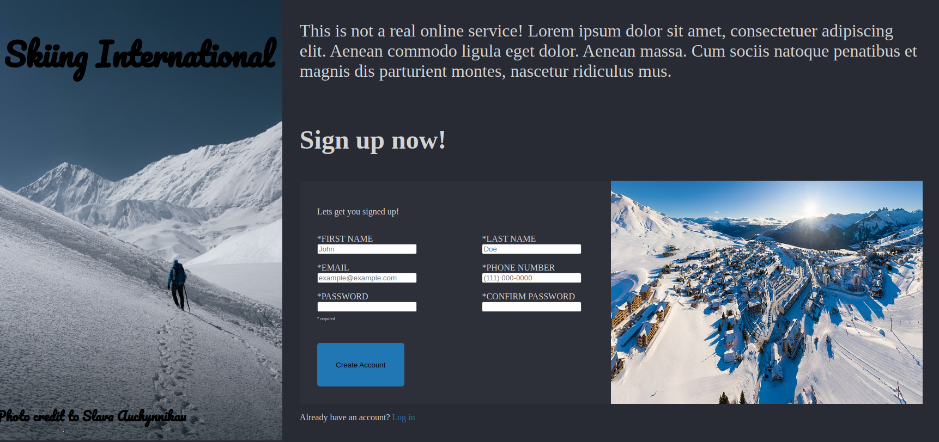
Verify Regular Functionality
To verify the Regular Functionality we will test that the form functions as expected.
Example Form:
(Blair, 2023)

Slide 10
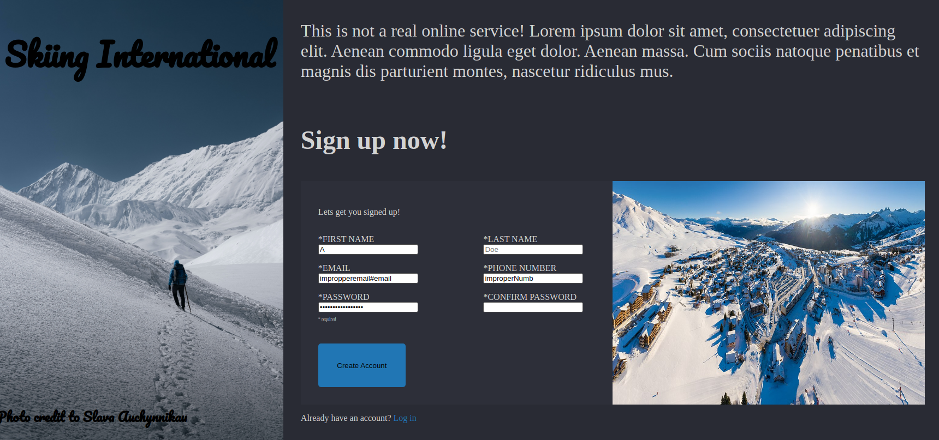
Verify Front End Check
To Verify that the front end is checking information we need to make sure the form cannot be submitted without proper formatting
Example Form:
(Blair, 2023)

Slide 11
Verify Back End Check
To verify the back end is checking form inputs properly we need to ensure that:
The input from the form was in the proper format
Prepared statements are being used to prevent potential injection attacks
The username and password are a valid combination

Slide 12
Front End Injection Prevented
The front end has no logic however, injection attacks will be prevented on the front end through invalid characters, long usernames, and improper formatting.
To complete this test we will submit the form with SQL statements in the username, password, and email lines

Slide 13
Back End Injection Prevented
The back end contains all the logic for user verification and SQL injection defense. To test that the logic is properly implemented we will:
Submit the form with invalid username, password, and both
Submit the form with valid username but an SQL statement in the password
Submit the form with valid password but an SQL statement in the username

Slide 14

AUTOMATION SUMMARY

Slide 15
TOOLS
List of external tools:
Astree
CodeSonar
Coverity
Cppcheck
Helix QAC
Parasoft
Axivion Bauhaus Suite
The Checker Framework
FindBugs
Compass/Rose
Jtest
Fortify
PMD
Klocwork
LDRA tool suite

Slide 16
RISKS AND BENEFITS
There are always holes in defense
If an attack has already happened it is too late
We are lacking in offensive defense

Slide 17
RECOMMENDATIONS
Offensive Security
Physical Security

Slide 18
REFERENCES
Blair, Hatcher (2023). Form Webpage (not a public website)

